Slide 1
WCAG 2.0 Standards
PSYCHOLOGY 562:
Advanced human factors
Miriam Del Cerro

Slide 2
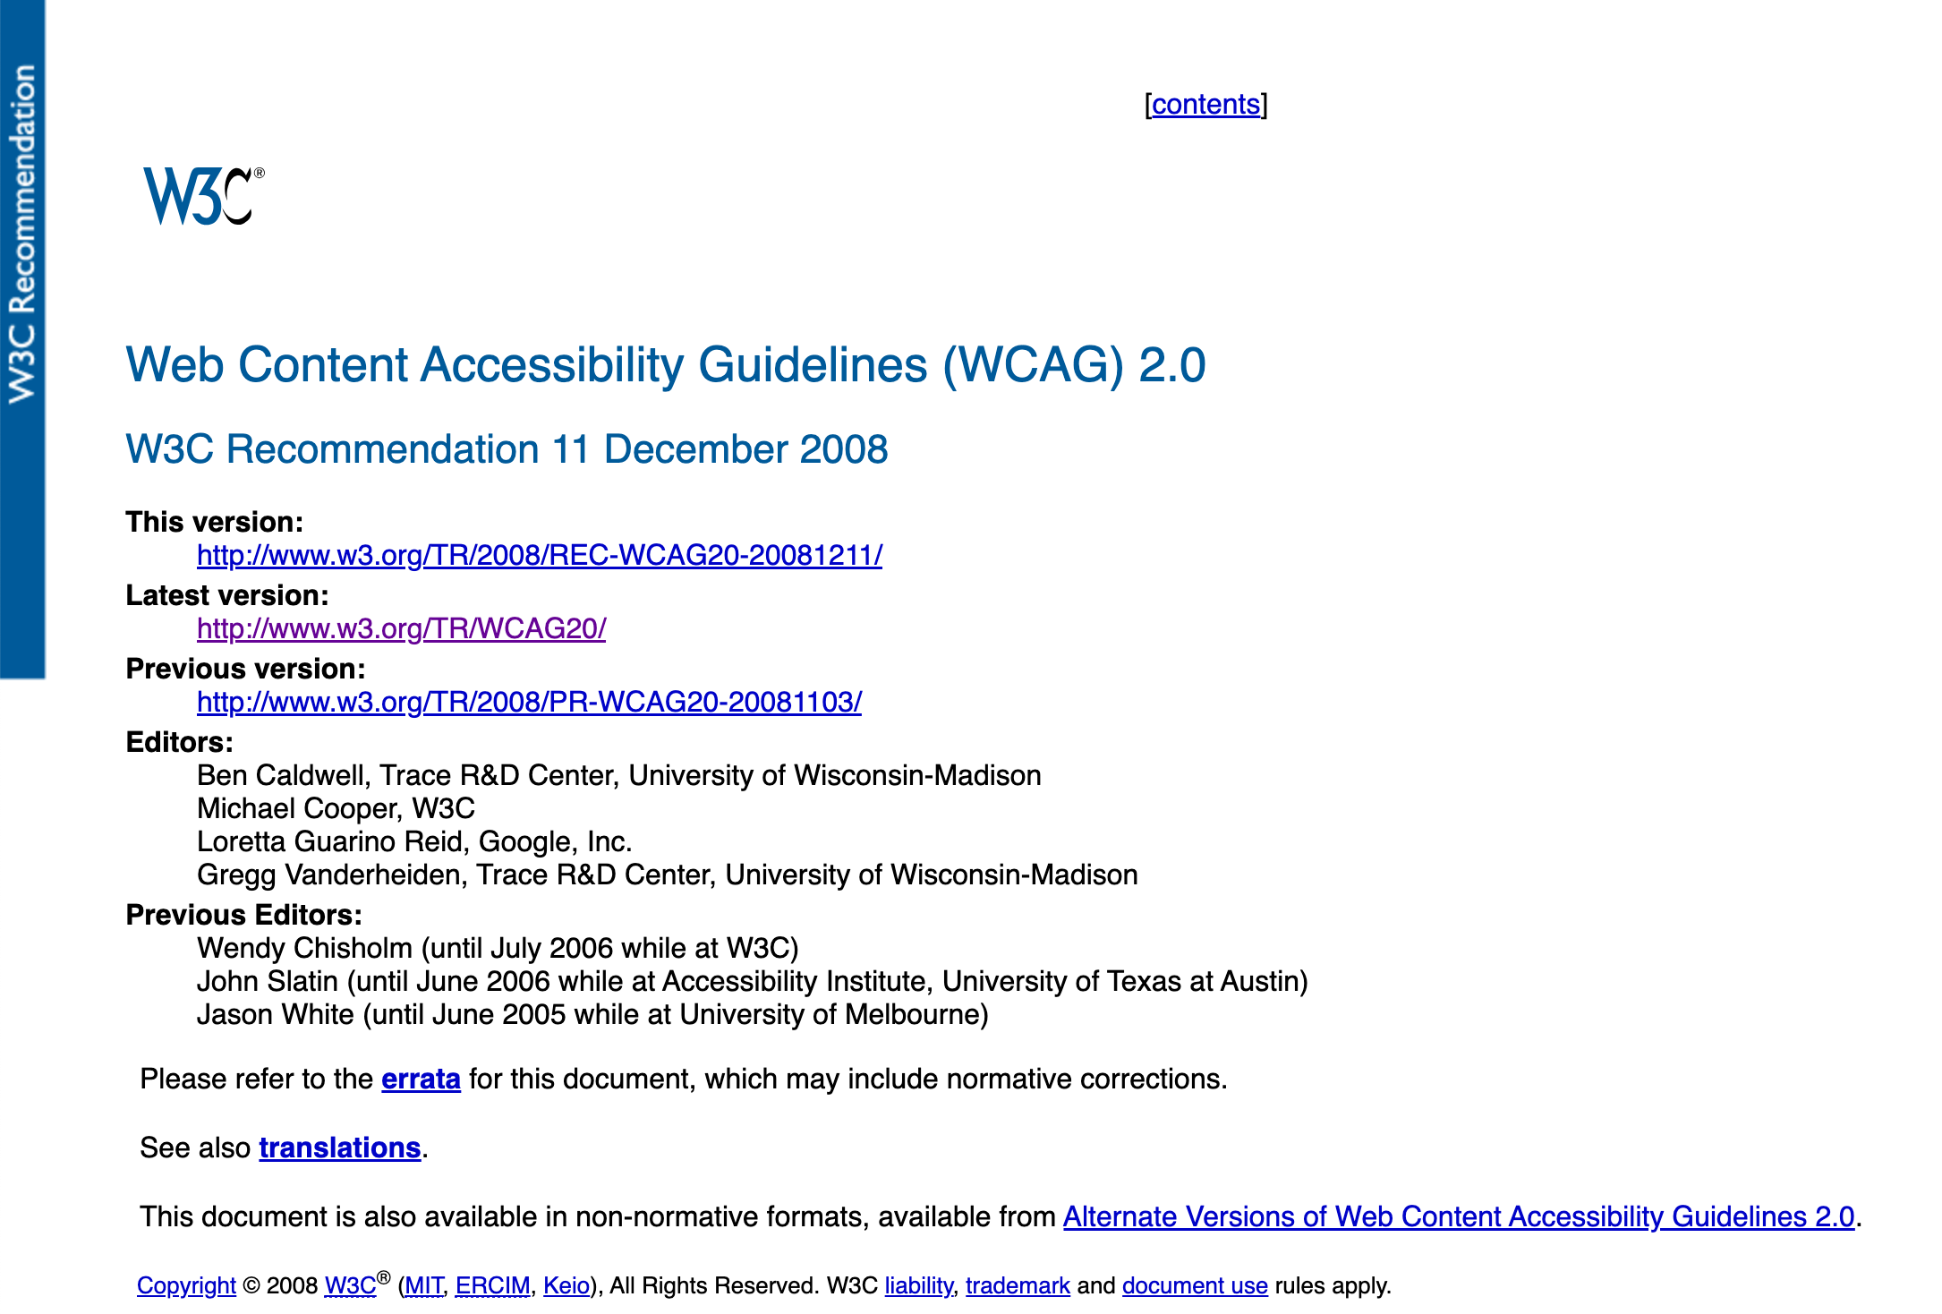
Overview
Defining "accessible" in this context
Why design the web for accessibility?
What is WCAG 2.0?
Conformance levels
Principles and guidelines
Tools for checking conformance

Slide 3
"Accessible"
"Usable to a wide range of people with disabilities, including blindness and low vision, deafness and hearing loss, learning difficulties, cognitive limitations, limited movement, speech difficulties, photosensitivity and combinations of these." (WCAG 2.0)
Enables access to web content using different devices including assistive technologies.
https://www.w3.org/TR/WCAG20/
Notes:
"Accessible" means usable to a wide range of people with disabilities, including blindness and low vision, deafness and hearing loss, learning difficulties, cognitive limitations, limited movement, speech difficulties, photosensitivity and combinations of these.
Following these guidelines will also make your Web content more accessible to the vast majority of users, including older users. It will also enable people to access Web content using many different devices - including a wide variety of assistive technologies.

Slide 4
"Assistive technology"
They provides services beyond those offered by the website/software to meet the requirements of users with disabilities.
Additional services include alternative renderings, alternative input methods, additional navigation or orientation mechanisms, and content transformations.
https://www.w3.org/TR/2006/WD-WCAG20-20060427/appendixA.html#atdef
Notes:
A user agent that relies on services (such as retrieving Web content and parsing markup) provided by one or more other "host" user agents. Assistive technologies communicate data and messages with host user agents by using and monitoring APIs.
They provides services beyond those offered by the host user agents to meet the requirements of users with disabilities. Additional services include alternative renderings (e.g., as synthesized speech or magnified content), alternative input methods (e.g., voice), additional navigation or orientation mechanisms, and content transformations (e.g., to make tables more accessible).

Slide 5
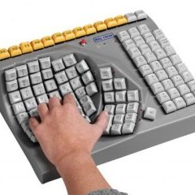


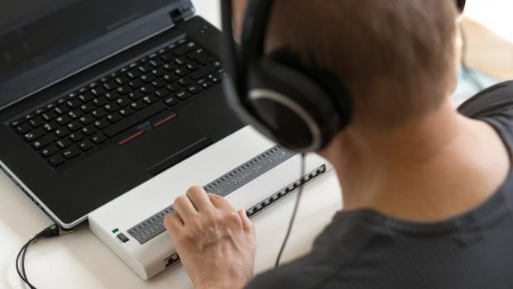
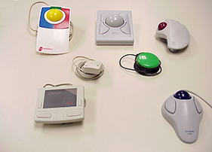
Assistive Technology
Examples
screen magnifiers
screen readers
voice recognition software
alternative keyboards
alternative pointing devices
Notes:
Example: Examples of assistive technologies that are important in the context of this document include the following: screen magnifiers, which are used by people with visual disabilities to enlarge and change colors on the screen to improve the visual readability of rendered text and images; screen readers, which are used by people who are blind or have reading disabilities to read textual information through synthesized speech or braille displays; voice recognition software, which may be used by people who have some physical disabilities; alternative keyboards, which are used by people with certain physical disabilities to simulate the keyboard; alternative pointing devices, which are used by people with certain physical disabilities to simulate mouse pointing and button activations.
https://images.app.goo.gl/jhxJh3UcQFhGtQUS6
https://images.app.goo.gl/dyQxZCyNcaDbevyb9
https://images.app.goo.gl/1LZuiwsF6nCUMPYr8
https://images.app.goo.gl/n5SxjN3gJxREyjX6A
https://images.app.goo.gl/ysYxNpN7fAMfeyuJ6

Slide 6
Why design the web for accessibility?
Users face barriers accessing digital content due to vision, hearing, motor, and cognitive limitations (as well as barriers in the environment due to lack of physical access).
Legal case: Avoid accessibility and anti-discrimination lawsuits.
Moral case: Universal access is the goal for corporate social responsibility.
Business case: Accessibility supports SEO, mobile friendly and responsive design.
Designing for accessibility means designing for ALL users.
Notes:
Barriers in the environment due to lack of physical access – think about trying to enter a destination on google maps while driving, you need voice control for that. Or setting a kitchen timer when your hands are full (alexa or google home)
Legal case: In the US, per Section 508 of the ADA federal agencies must develop, procure, maintain, and use Information and Communication Technology (ICT) that is accessible to people with disabilities, with exceptions for undue hardship. ICT includes websites, software, and electronic documents.
Moral case from a business's perspective
Design for accessibility allows products and services to be usable and available to the broadest range of users.

Slide 7
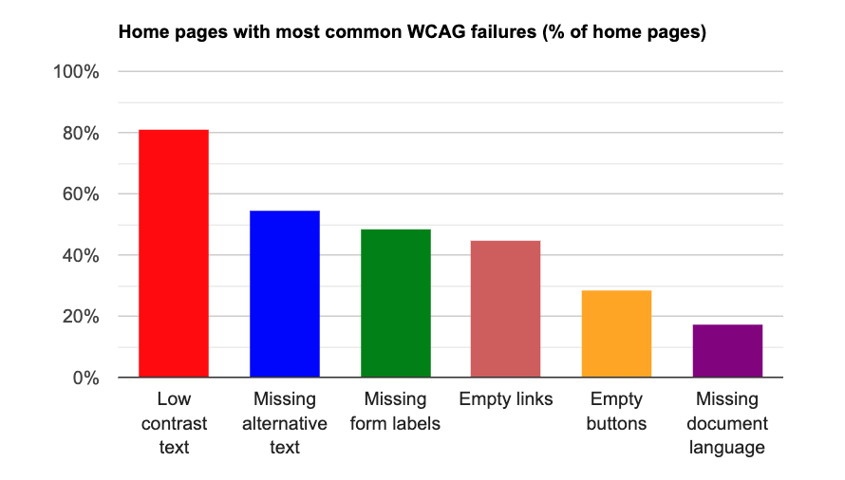
Still work to be done...
In a 2023 study of 1M websites by AIM, 98.1% of home pages had detectable WCAG failures.
The most frequent error types have persisted over the past five years, according to AIM.
Study by WebAIM.org (Web Accessibility in Mind)
Notes:
https://webaim.org/projects/million/#wcag
Even with pages that look good at first glance, these are common accessibility errors that many websites lack. They are things that are often code-based like missing alternative text, empty links, and empty buttons, things that you won't notice unless you're interacting with it or need to use APIs to read what the page contains.

Slide 8
Web Content Accessibility Guidelines (WCAG) international standard
First published in 1999 by W3.org, the World Wide Web Consortium.
WCAG 2.0 was published in 2008. WCAG 3.0 was published in 2024 to restructure the guidelines.
WCAG 2.1 addressed responsive web design. In 2022, WCAG 2.2 added guidance for cognitive or learning disabilities, low vision, and mobile device usage.
Notes:
Just some history of the standard...
First established in 1999 and has had a couple of revisions since then.

Slide 9
Success Criteria for guidelines
Level 1:
Achieve a minimum level of accessibility.
Can reasonably be applied to all Web content.
Level 2:
Achieve an enhanced level of accessibility.
Can reasonably be applied to all Web content.
Level 3:
Achieve additional accessibility enhancements.
Can not necessarily be applied to all Web content.

Slide 10
Conformance Levels
Measuring accessibility
Level A: all Level 1 success criteria in the guidelines are met
Level AA: all Level 1 and all Level 2 success criteria in the guidelines are met
Level AAA: all Level 1, Level 2 and at least half (50%) of the Level 3 success criteria that apply to the content types used are met
(All levels assume user agent support for only the technologies in the specified baseline)
Notes:
user agent
any software that retrieves and renders Web content for users
Example: Web browsers, media players, plug-ins, and other programs — including assistive technologies — that help in retrieving and rendering Web content.
WCAG AA and AAA refer to the two highest levels of conformance within the Web Content Accessibility Guidelines (WCAG), with AA being the mid-range level considered widely acceptable, and AAA being the most stringent level, representing the highest possible accessibility standard on a website; both levels build upon the basic "A" level, meaning that achieving AA compliance automatically includes meeting A level requirements, and AAA includes both A and AA levels.

Slide 11
"POUR" principles
Perceivable
Operable
Understandable
Robust

Slide 12
Principle 1: Content must be perceivable
Guideline 1.1 Provide text alternatives for all non-text content
Guideline 1.2 Provide synchronized alternatives for multimedia
Guideline 1.3 Ensure that information and structure can be separated from presentation
Guideline 1.4 Make it easy to distinguish foreground information from its background
Notes:
What are some ways to make sure your website is perceivable?
Text-alternatives to graphs, images, visuals
Descriptive text
Different forms of portraying the system status
Mark pure decoration content to be ignored by assistive technology
Captions
Audio descriptions
Sign language interpretation (level 3)
Don't rely on color alone for information
information and relationships conveyed through presentation can be programmatically determined,
Information required to understand and operate content does not rely on shape, size, visual location, or orientation of components
Contrast ratio 5:1 (level 2)
Audio content does not contain background sounds, background sounds can be turned off, or background sounds are at least 20 decibels lower than the foreground audio content

Slide 13
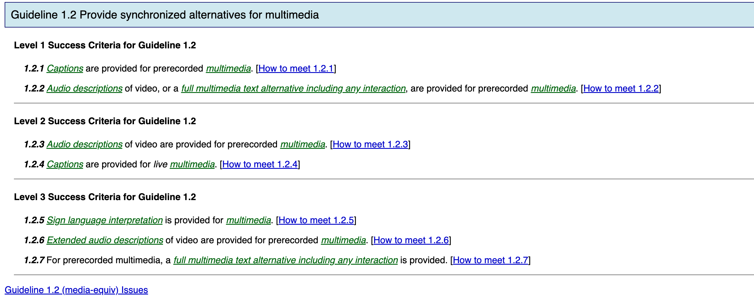
Notes:
Example of the 3 levels of success criteria for a guideline. Not all guidelines have success criteria for all 3 levels.

Slide 14
Principle 2: Interface components in the content must be operable
Guideline 2.1 Make all functionality operable via a keyboard interface
Guideline 2.2 Allow users to control time limits on their reading or interaction
Guideline 2.3 Allow users to avoid content that could cause seizures due to photosensitivity
Guideline 2.4 Provide mechanisms to help users find content, orient themselves within it, and navigate through it
Guideline 2.5 Help users avoid mistakes and make it easy to correct mistakes that do occur
Notes:
What are some ways to make sure the website is operable?
Content does not blink for more than three seconds
content can be paused by the user (level 2)
Interruptions, such as updated content, can be postponed or suppressed by the user
Content cannot flash more than 3 times per second (level 3)
Web units have titles
Users can skip through repeated web units
Links are associated with things
Titles, headings, and labels are descriptive
More than one way to locate content
The purpose of each link can be programmatically determined from the link
Provide breadcrumbs (level 3)
Actions are reversivle (level 2)
Context-sensitive help (level 3)

Slide 15
Principle 3: Content and controls must be understandable
Guideline 3.1 Make text content readable and understandable.
Guideline 3.2 Make the placement and functionality of content predictable.
Notes:
How can we make sure the website is understandable?
The primary natural language or languages of the Web unit can be programmatically determined.
Help the user find definitions (level 3)
Help the user find abbreviations (level 3)
Help users find pronunciation (level 3)
When any component receives focus, it does not cause a change of context.
Changing the setting of any form control or field does not automatically cause a change of context
Steps are logical
Components that have the same functionality are consistent (level 2)
Changes of context are initiated only by user request. (level 3)

Slide 16
Principle 4: Content should be robust enough to work with current and future user agents (including assistive technologies)
Guideline 4.1 Support compatibility with current and future user agents (including assistive technologies)
Guideline 4.2 Ensure that content is accessible or provide an accessible alternative
Notes:
How can we make sure the website is robust?
Help assistive technologies parse the website components
For all user interface components, the name and role can be programmatically determined, values that can be set by the user can be programmatically set,
If content can be entered using the keyboard, then the content can be exited using the keyboard.

Slide 17
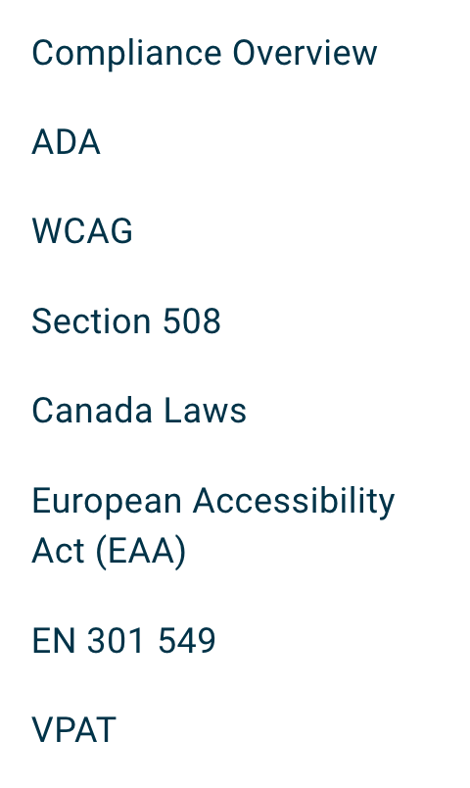
Tools for Checking Conformance
WebAIM https://webaim.org/resources/contrastchecker/
Contrast and color ratio
Axe https://www.deque.com/axe/
Chrome extension to the developer tools
ADA, WCAG, Section 508...
Notes:
Americans with Disabilities Act (ADA)
Section 508 compliance means that information and communication technology (ICT) is accessible to people with disabilities. It's a federal law that applies to all federal agencies.

Slide 18
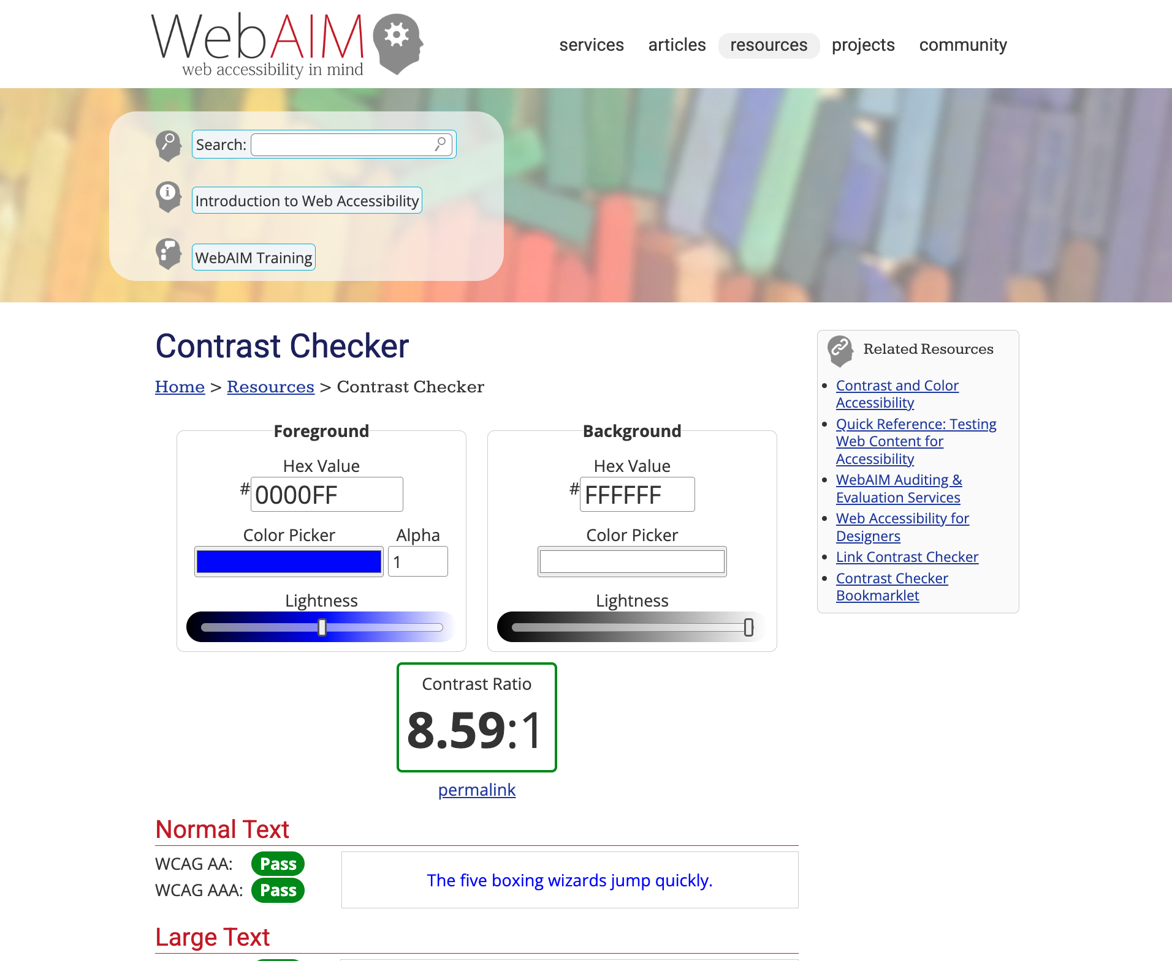

Slide 19
